Slide 1
T.A.K CHAITANYA
FINAL PROJECT

Slide 2
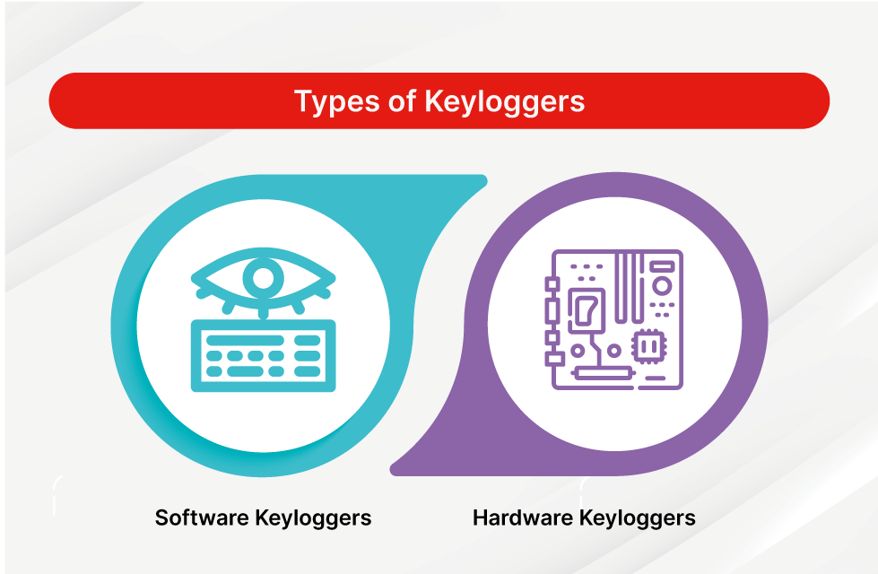
PROJECT TITLE:- KEYLOGGER AND SECURITY
Keyloggers are software or hardware tools used to record and monitor keyboard input, including passwords, messages, and other sensitive information. They play a crucial role in cybersecurity, both for defense and ethical hacking purposes.
There are two types of keyloggers:-
1)Software keylogger
2)Hardware keylogger

Slide 3
AGENDA
Keyloggers refer to software programs or hardware devices that are created to record each key that you type on your computer or device. The goal of a keylogger is usually acquire helpful identifications like usernames, passwords, credit card information but also to other confidential information in addition to that. This information can be exploited for identity theft, financial fraud, or illegal entry into accounts. You must be careful and allow your devices to be clear of the keyloggers by downloading a good Antivirus and then, well, by taking care of the sites you visit and the links you click on.

Slide 4




FUNCTIONALITY AND FEATURES:-
Screenshot Clipboard Network password
capture :- monitoring :- monitoring :- protection:-
Keylogger can take It can track the content It can monitor network It protects the password
Period as to provide including copied traffic and detect the or encryption to secure
Additional context passwords and the suspicious online the collection of the
About user sensitive information activities data

Slide 5
ETHICAL CONSIDERATION
1) Legal Compliance
The use of keyloggers must comply with local laws and regulations regarding privacy and data protection.
2) 2) Informed Consent:-
Keyloggers should only be used with the explicit consent of the affected parties to avoid privacy violations.
3) Responsible Disclosure:-
Any vulnerabilities discovered through keylogging should be reported to the affected parties in a responsible manner.
4) Secure Data Handling:-
Collected data from keyloggers must bestored and handled securely to prevent unauthorized access or misuse.

Slide 6
PROBLEM STATEMENTS
The main context of this is “understanding the threat of Keyloggers and Enhancing Security Measures”
In today's digital age, cybersecurity threats are increasingly sophisticated, posing significant risks to individuals and organizations. Among these threats, keyloggers are particularly insidious due to their ability to record keystrokes, capturing sensitive information such as passwords, credit card numbers, and personal data without the user's knowledge.
Importance:- Understanding keyloggers and implementing robust security measures is critical to protecting personal and organizational data from unauthorized access and potential breaches.

Slide 7
WHO ARE THE END USERS :-
Context:* The implementation of security measures against keyloggers is crucial for a broad range of end users who are vulnerable to cyber threats. Understanding who these end users are helps in tailoring security solutions to their specific needs.
1)Individual Users:- : Like ,General Public, Personal Security, Education
2) Small and Medium-sized Enterprises (SMEs):-
Like , Business Operations, Financial Security, Reputation Management.
3)Large Corporations:- Like, Corporate Data, Employee Security, Compliance
4) IT Professionals and Cybersecurity Experts:-Like ,Network Security,Incident Response,User Education.
5)E-commerce Businesses:- Like , Customer Data, Transaction Security
6)High-Profile Individuals:-Like, Personal Security, Privacy security

Slide 8
MODELLING :-
The modeling process involves understanding how to capture keyboard inputs, handle different types of keystrokes, and ensure the keylogger remains undetected by the user. It's crucial to consider the ethical implications of creating such software and to use this knowledge responsibly.
To model a keylogger, you would typically need to create a program that can intercept and record keystrokes on a computer. This program would run in the background, capturing the keys pressed by the user. The keylogger would then store this information in a log file or send it to a remote location.

Slide 9
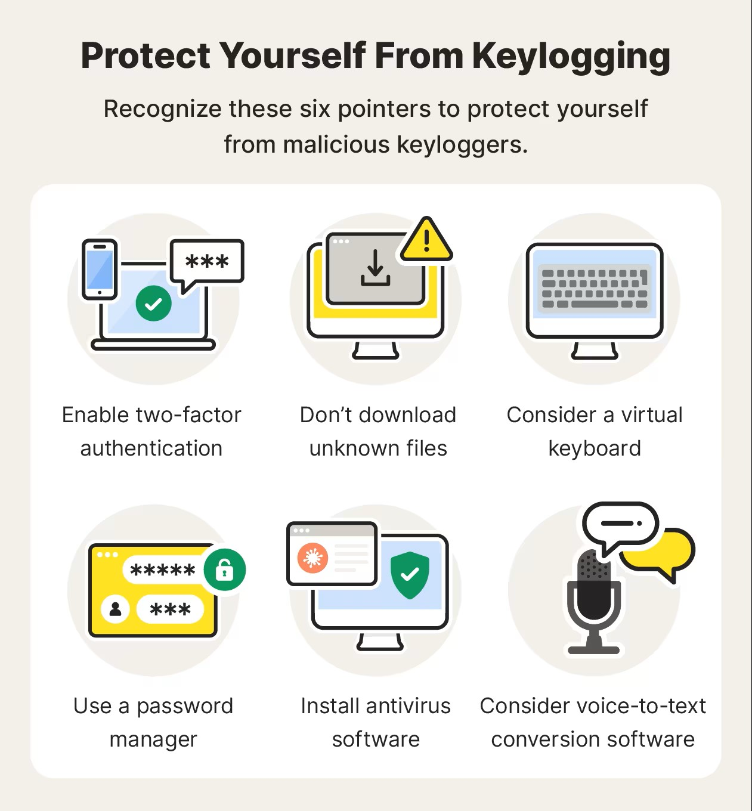
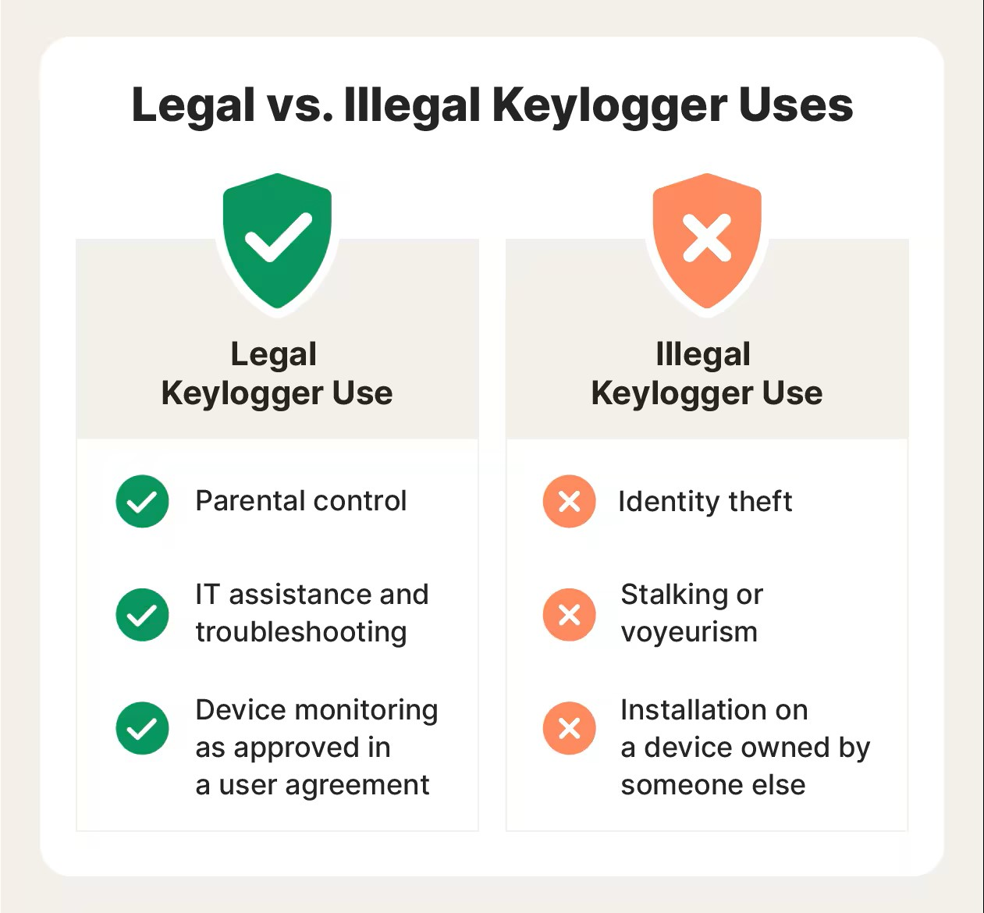
PROTECTION:-

Slide 10
ADVANTAGES | DISADVANTAGES
Can monitor user activity | Invasion of privacy
Useful for parental control | Can be used for malicious purposes
Helps in recovering lost data | Can lead to identity theft
Can enhance security in workplaces | Often illegal without consent
Assists in employee monitoring | May be detected by antivirus software

Slide 11
APPLICATIONS :-
Keyloggers can have legitimate uses in certain contexts, such as
1)Parental Control: Parents can use keyloggers to monitor their children's online activities and ensure they are safe from harmful content or interactions.
2) Employee Monitoring: Employers may use keyloggers to track employee activities on company computers to prevent data breaches or ensure compliance with company policies.
3)Law Enforcement: Keyloggers can be used by law enforcement agencies as a tool for investigating criminal activities and gathering evidence.

Slide 12
PROJECT OVERVIEW:-
It captures user input, including passwords and personal information, without their knowledge. Keyloggers can be used for legitimate purposes, such as monitoring employee activity or recovering lost data, but they are often associated with malicious activities like stealing sensitive information. The main components of a keylogger project include:
Data Capture: Recording keystrokes.
Data Storage: Storing the captured keystrokes in a file or sending them to a remote server.
User Interface: An interface for configuring and managing the keylogger.
Security Measures: Techniques to hide the keylogger from detection and protect the collected data.

Slide 13
RESULT /OUTPUT :-
The output of a keylogger typically consists of a log file that records the keystrokes captured from the keyboard. This log file can include:
Keystrokes: Each key pressed by the user, often including special keys like Enter, Backspace, and Shift.
Timestamps: The date and time when each keystroke was recorded.
Application Information: The name of the application or window where the keystrokes were entered.
Contextual Information: Additional data such as screenshots, URLs visited, or clipboard content, depending on the sophistication of the keylogger.

Slide 14
PROJECT LINK
https://github.com/ThotaAnand21/keylogger-and-security.git

Slide 15
THANK YOU

